Slide 1
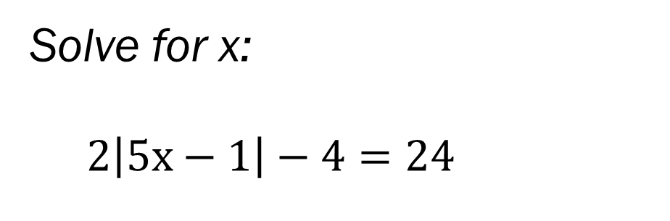
Bell Work
Solve for x:
$2\left|5x−1\right|−4=24$
How far apart are these 2 points:
(5, 2) and (-7, 3)

Slide 2
From last time…
New Material
Page 78 #4-6, 23, 31, 37, 50
Mixed Review
Page 80 #68, 69, 71

Slide 3
ALGEBRA 3
Day 12

Slide 4

Algebra 3 Quiz 2 Level 2:
Solve for x, if possible.
$$1.) \left|2x−9\right|+4=17$$
Solve for t, if possible.
$$2.) 20=5\left|7t+1\right|+30$$
Solve for w, if possible.
$$3.) 2\left|w−3\right|+1<21$$

Slide 5
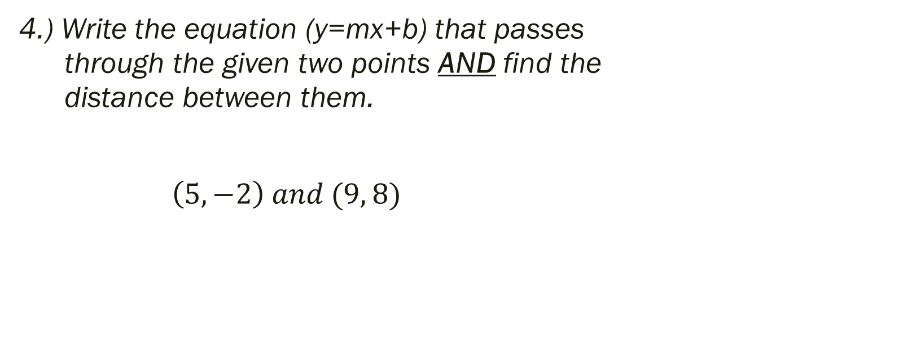
Algebra 3 Quiz 2 Level 3:
4.) Write the equation (y=mx+b) that passes through the given two points AND find the distance between them.
$\left(5, −2\right) and (9, 8)$

Slide 6
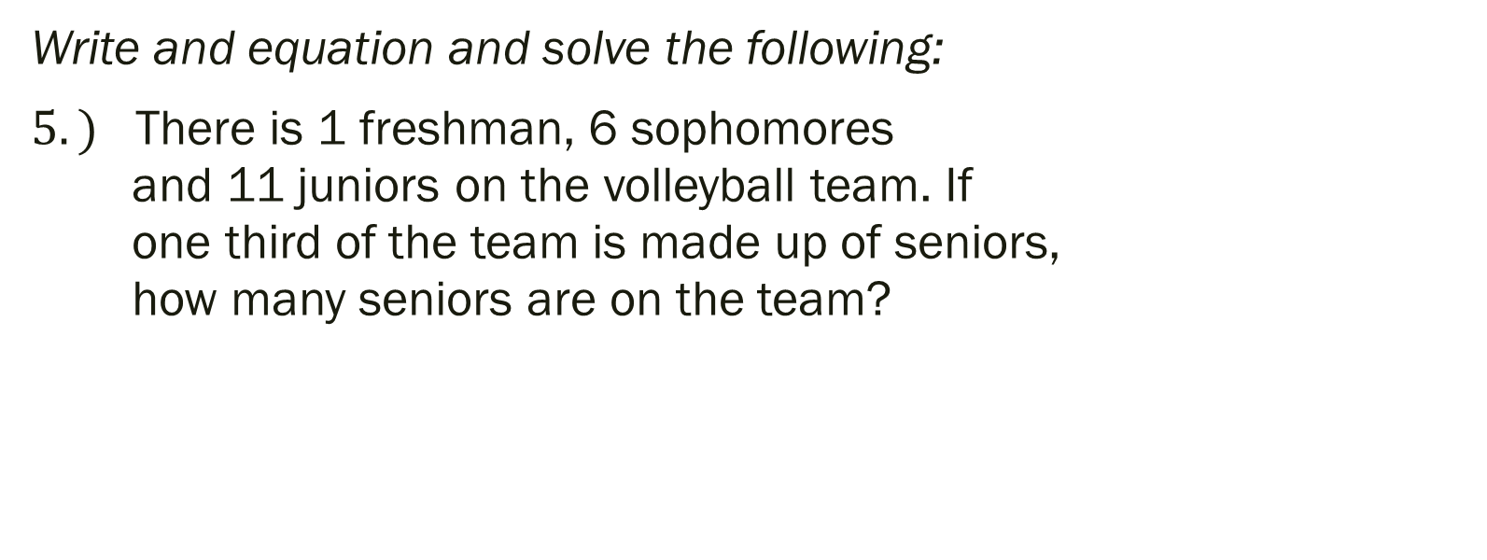
Algebra 3 Quiz 2 Level 4:
Write and equation and solve the following:
$5.)$ There is 1 freshman, 6 sophomores and 11 juniors on the volleyball team. If one third of the team is made up of seniors, how many seniors are on the team?

Slide 7
Things to Study for the Test
Solve equations for the indicated variable
Solve inequalities and graph on number line
Solve absolute value
Solve equations with several steps
Solve compound inequalities
Graph a line
Write equation of line and tell how far apart two points are
Write an equation and solve it based on a story problem

Slide 8
For Test Prep…
Page 51 #14-15, 18-26, 28-34
Page 53 #13, 17
Page 124 #17-25 (odd)

